Slide 1

SRI VENKATESWARA COLLEGE OF ENGINEERING
(AUTONOMOUS)
DEPARTMENT OF ELECTRONICS AND COMMUNICATION ENGINEERING
SECTION–ECE-B
BATCH NO -13
High-Efficiency Synchronous Binary Counter with Minimal Clock period Using Optimized Parallel Architecture
TEAM MEMBERS:
KUNCHAM JHANSI MEGHANA 21BF1A04B9
M REDDY REKHA 21BF1A04C2
MOPUR S MOHITH 21BF1A04C3
V CHAITHANYA 21BF1A04C8
YADIKI ANITHA 22BF5A0414
UNDER THE ESTEEMED GUIDANCE OF:
Mrs.K.Amala, M.Tech
Asst.Professor
SV COLLEGE OF ENGINEERING, TIRUPATI

Slide 2

CONTENTS
Problem Identification
Objectives
Abstract
Introduction
Motivation of the Project
Existing Method & Dis-advantages
Proposed Method
Block Diagram & Methodology
Tools Required
Advantages & Applications
Results and discussions
Conclusion
Future Scope
References
Publication details
SV COLLEGE OF ENGINEERING, TIRUPATI
Dept. of ECE

Slide 3
PROBLEM IDENTIFICATION
Propagation Delay: Sequential carry propagation limits clock speed.
High Power Consumption: Unnecessary toggling increases energy usage.
Scalability Issues: Performance degrades with higher bit-width.
Need for Optimization: Lack of parallelism affects efficiency in high-speed systems.
SV COLLEGE OF ENGINEERING, TIRUPATI
Dept. of ECE

Slide 4
OBJECTIVES
Minimize Clock Period: Design a binary counter with reduced propagation delays.
Enhance Performance: Achieve high-speed operation with efficient parallel architecture.
Improve Scalability: Ensure the counter performs efficiently for higher bit-widths.
Reduce Power Consumption: Optimize the design for energy-efficient applications.
SV COLLEGE OF ENGINEERING, TIRUPATI
Dept. of ECE

Slide 5
ABSTRACT
An ideal parallel design for a clock-period minimal constant-time synchronous binary counter is presented in it. The architecture makes use of two types of 8-bit synchronous binary counters: one that uses a ripple carry chain and the other that uses backward carry propagation. In addition, it presents an altered 64-bit prescaled counter that generates prescaled enable signals by means of ring counters. Our proposed design shows considerable benefits over current approaches. which has 131 area registers, 68 LUTs, and 66 IOBs, the suggested method uses 99 area registers, 65 LUTs, and 66 IOBs, reducing the area footprint in terms of hardware resources. the current method's latency is 1.172 ns, but the new architecture's latency is 0.978 ns. Additionally, the suggested approach shows improved power efficiency, using only 0.00107 W as opposed to 0.0162 W for the current method.
SV COLLEGE OF ENGINEERING, TIRUPATI
Dept. of ECE

Slide 6
INTRODUCTION
A constant-time synchronous binary counter is a digital circuit designed to count in binary increments (or decrements) at a fixed and predictable rate. Unlike traditional counters that may experience variable delays due to carry propagation, a constant-time counter ensures that each count transition occurs within a consistent time interval.
This property is crucial in applications that require precise timing and synchronization, such as
communication systems
signal processing and
embedded systems.
SV COLLEGE OF ENGINEERING, TIRUPATI
Dept. of ECE

Slide 7
MOTIVATION OF THE PROJECT
Demand for Speed: Increasing need for high-speed counters in modern digital systems.
Power Efficiency: Importance of reducing energy consumption in low-power applications.
Scalability Challenges: Addressing inefficiencies in traditional counters for larger bit-widths.
Technological Advancement: Leveraging optimized parallel architectures for better performance.
SV COLLEGE OF ENGINEERING, TIRUPATI
Dept. of ECE

Slide 8
EXISTING METHOD
Traditional Synchronous Counter:
It uses a clock to update flip-flops at the same time but can be based on different counting systems (e.g., binary, decimal).
How It Works: All parts of the counter are updated together with the same clock signal.
Components: Consists of flip-flops, gates, and a clock generator to manage the timing.
SV COLLEGE OF ENGINEERING, TIRUPATI
Dept. of ECE

Slide 9
DISADVANTAGES
Slower Speed: The speed is limited by the slowest part of the counter.
High Power Consumption: More components mean higher power usage.
Scaling Issues: As the counter size grows, delays and power consumption increase.
Difficult to Design: Synchronizing all parts becomes challenging with more bits.
SV COLLEGE OF ENGINEERING, TIRUPATI
Dept. of ECE

Slide 10
PROPOSED METHOD
Parallel Architecture with Minimized Clock Period
Parallel Architecture: Divide the counter into smaller parallel units to process multiple bits simultaneously. Reduces overall delay by allowing faster individual bit updates.
Minimized Clock Period: Optimize logic to reduce the time needed for each clock cycle. Uses faster gates and optimized flip-flops to achieve high-speed performance with a shorter clock period
SV COLLEGE OF ENGINEERING, TIRUPATI
Dept. of ECE

Slide 11
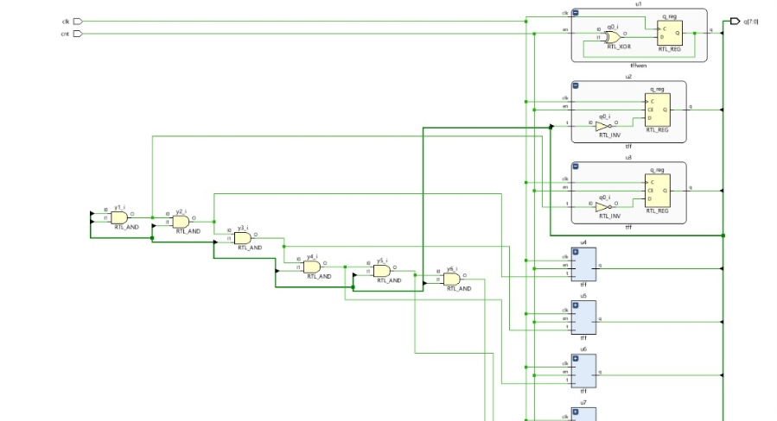
BLOCK DIAGRAM
SV COLLEGE OF ENGINEERING, TIRUPATI
Dept. of ECE

Slide 12
METHODOLOGY
Requirements Analysis -Identify Core Requirements - Analyze Constraints
Architectural Design -Choose Architecture - Optimize for Performance
Logic Design -Design the Counter Logic -Optimize the Design
Synthesis and Simulation -Synthesize the Design -Simulate the Design
Physical Design - Place and Route -Clock Tree Synthesis
6. Verification and Testing - Static Timing Analysis (STA) - Formal Verification-Testing
Implementation and Testing-FPGA Implementation -ASIC Implementation
SV COLLEGE OF ENGINEERING, TIRUPATI
Dept. of ECE

Slide 13
REQUIREMENTS
Software Requirements
* Xilinx ISE 14.7
Hardware Requirements
* Hard Disk – 1GB
* RAM – 4GB
* Laptop
* Windows – 10 OS
SV COLLEGE OF ENGINEERING, TIRUPATI
Dept. of ECE

Slide 14
ADVANTAGES
Reduced Clock Period: Achieves faster counting speeds by minimizing propagation delays.
High Performance: Optimized parallel architecture ensures quick transitions between states.
Improved Accuracy: Synchronous design eliminates glitches common in asynchronous counters.
Energy Efficiency: Reduced power consumption due to streamlined logic and minimized clock cycles.
SV COLLEGE OF ENGINEERING, TIRUPATI
Dept. of ECE

Slide 15
APPLICATIONS
Digital Signal Processing (DSP)
Real-Time Systems
Microprocessors and CPUs
Frequency Division
Communication Systems
Embedded Systems
Measurement and Test Equipment
Cryptographic Applications
SV COLLEGE OF ENGINEERING, TIRUPATI
Dept. of ECE

Slide 16
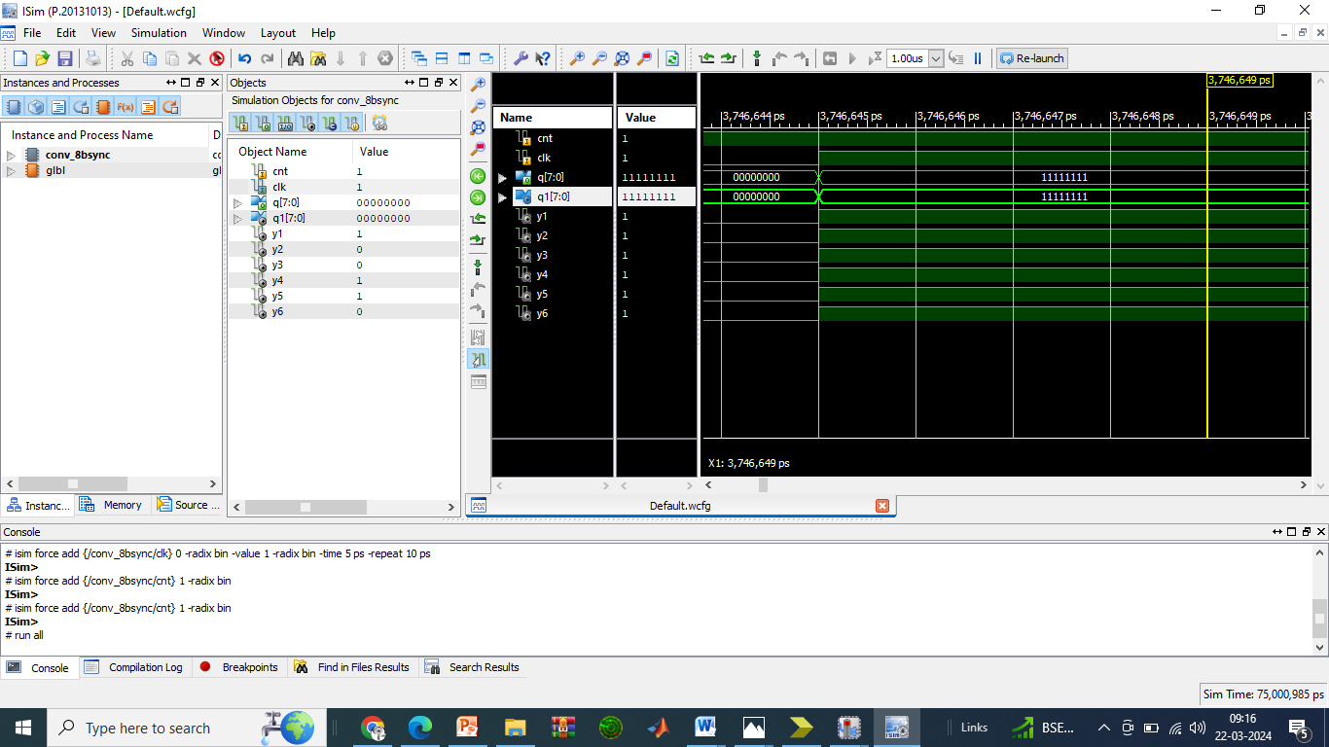
RESULT
SV COLLEGE OF ENGINEERING, TIRUPATI
Dept. of ECE

Slide 17
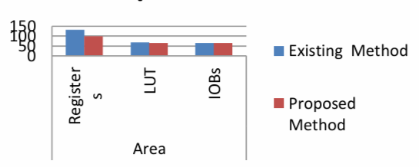
DISCUSSIONS
Showing Area Performance comparison of Existing and Proposed method
s.no | Model | Registers | LUT | IOB s | Delay (ns) | Power (w)
1 | Existing Method | 131 | 68 | 66 | 1.172 | 0.0162
2 | Proposed Method | 99 | 65 | 66 | 0.978 | 0.0010 7
Dept. of ECE
SV COLLEGE OF ENGINEERING, TIRUPATI

Slide 18
CONCLUSION
In conclusion, the proposed high-efficiency synchronous binary counter achieves a minimal clock period through an optimized parallel architecture. By reducing propagation delays and enhancing synchronization, the design ensures faster and more reliable operation. The use of parallel processing significantly improves performance while maintaining low power consumption. This approach is highly suitable for high-speed digital systems requiring precise timing.
Overall, the optimized architecture offers an effective solution for modern high-performance computing applications.
Dept. of ECE
SV COLLEGE OF ENGINEERING, TIRUPATI

Slide 19
FUTURE SCOPE
Low-Power Optimization – Further power reduction techniques, such as clock gating and dynamic voltage scaling, can be integrated for energy-efficient computing.
FPGA and ASIC Implementation – The architecture can be optimized for real-world implementation in FPGA and ASIC designs, enhancing practical usability in embedded systems.
AI and IoT Integration – The counter can be utilized in AI accelerators and IoT edge devices, where high-speed and low-latency processing are critical.
Adaptive Clocking Techniques – Future improvements can incorporate adaptive clocking mechanisms to dynamically adjust performance based on system requirements.
Dept. of ECE
SV COLLEGE OF ENGINEERING, TIRUPATI

Slide 20
REFERENCESS
[1] M.R. Stan, A.F. Tenca, M.D. Ercegovac, "Long and fast up/down counters", Computers IEEE Transactions on, vol. 47, no. 7, pp. 722-735, 1998.
[2] J. -. Yuan, "Efficient CMOS counter circuits," in Electronics Letters, vol. 24, no. 21, pp. 1311-1313, 13 Oct. 1988, doi: 10.1049/el:19880891.
[3] S. Abdel-Hafeez, S. M. Harb and W. R. Eisenstadt, "High speed digital CMOS divide-by-N frequency divider," 2008 IEEE International Symposium on Circuits and Systems, Seattle, WA, 2008, pp. 592-595, doi: 10.1109/ISCAS.2008.4541487.
SV COLLEGE OF ENGINEERING, TIRUPATI
Dept. of ECE

Slide 21
PUBLICATION DETAILS
Paper Title : High-Efficiency Synchronous Binary Counter with Minimal Clock period Using Optimized Parallel Architecture
Published In : International Journal of Innovative Research in Science, Engineering and Technology (IJIRSET)
Paper ID : IJIRSET.2025.14040232
Date of Issue: 04-04-2025
Status : Accepted and Published
Dept. of ECE
SV COLLEGE OF ENGINEERING, TIRUPATI

